Slide 1


Scott Mullin
October 12, 2021

Slide 2

Outline
Executive Summary
Introduction
Methodology
Results
Conclusion
Appendix

Slide 3
Executive Summary
Summary of Methodologies
We collected data by requesting the SpaceX API
Next, we used data scrapping techniques to import data from Wikipedia
We conducted EDA, building visualizations to interpret the data
SQL queries were run through python to answer business-specific questions
We constructed interactive maps using Folium to display the locations of specific launch sites, measure distances between the sites and major landmarks, and to add visual markers representing successes and failures
We then constructed an interactive dashboard, allowing users to drill down into the data and retrieve relevant information for business decisions
We then performed Logistic regression on the data and constructed confusion matrices to visualize True Positives and Negatives and False Positives and Negatives
Summary of Results
A year-over-year increase in success rates
A linear relationship between success rates and years indicates that the company is improving its techniques, technology or other factors leading to the improvement over time
KSC LC-39A had the most successful launches from all sites
There is a higher success rate when the payloads are lighter, generally speaking
The Decision Tree Classifier was the best model, with an 87.5% accuracy score
Accuracy was improved to 94.4% after hyperparameter tuning
The model resulted in zero False Negatives and 1 False Positive

Slide 4
Introduction
Project background and context
Space X advertises Falcon 9 rocket launches on its website with a cost of 62 million dollars; other providers cost upward of 165 million dollars each, much of the savings is because Space X can reuse the first stage. As a business consultant to the new startup Space Y, we have been asked to conduct a preliminary analysis of SpaceX launch activities to help predict a successful launch. By knowing if the first stage of a launch will land, we can better predict the cost of a launch.
This information can then be used to construct competitive bids against Space X, helping Space Y increase its market share in this incredibly competitive market.
Business questions to address
Can we confidently predict whether a launch will be successful or not based on historical data?
Is the cost of predicting an outcome higher if it is a False Negative or a False Positive?
Are launch sites built close to residential areas or other population-dense infrastructures?
Is SpaceX improving its successful mission outcome rate over time?

Slide 5


Slide 6
Methodology
Executive Summary
Data collection methodology:
Data was collected by making a request to the SpaceX Rest API with additional information supplemented via web-scrapping techniques
Perform data wrangling
We performed web scraping to collect Falcon 9 historical launch records from a Wikipedia page titled `List of Falcon 9 and Falcon Heavy launches` available at: Wikipedia Link
Perform exploratory data analysis (EDA) using visualization and SQL
Perform interactive visual analytics using Folium and Plotly Dash
Perform predictive analysis using classification models

Slide 7
Data Collection
Data regarding SpaceX launch information, payloads, rocket versions, landing outcomes etc were collected by requesting SpaceX Rest API and by web scrapping the Wikipedia page: “List of Falcon 9 and Falcon Heavy launches”.
The two processes can be viewed below…
SpaceX API
Wikipedia Page Web Scrapping
Request SpaceX REST API
API returns SpaceX JSON data
Normalize the data as .csv file
Request html from Wikipedia
Use Beautiful Soup to extract data
Normalize the data as .csv file

Slide 8
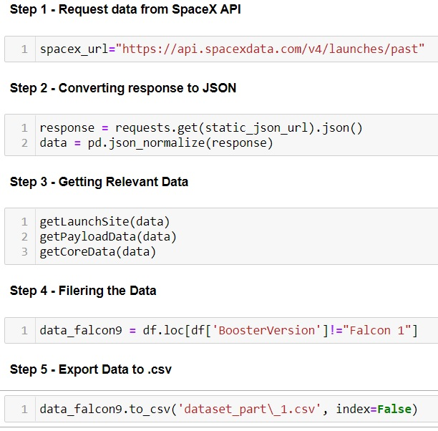
Data Collection – SpaceX API
Data was collected from the SpaceX API using the process found to the right…
Github url:
Link to Github

Slide 9
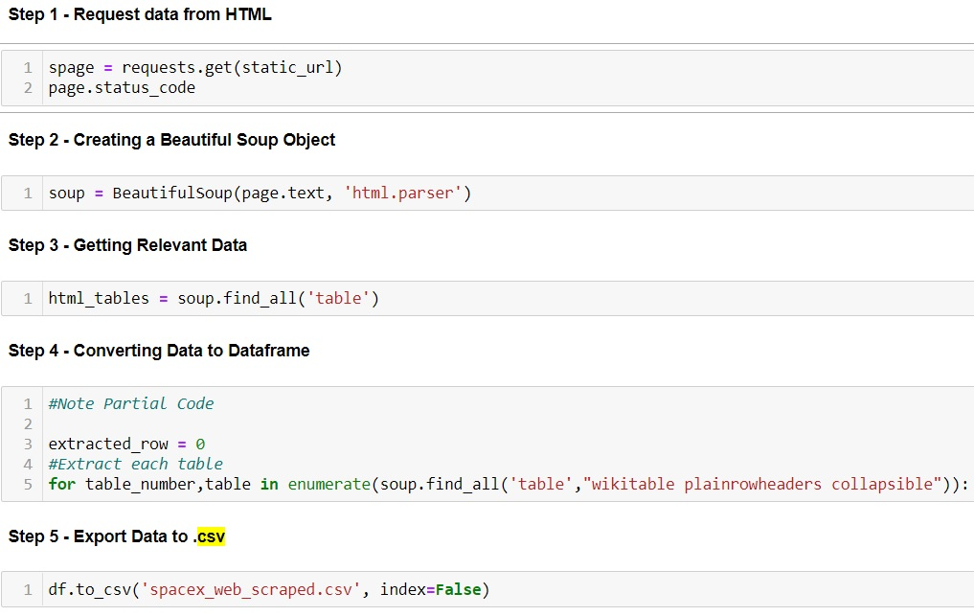
Data Collection - Scraping
Data was collected from the Wikipedia html using the web scrapping technique found to the right:
Link to Github

Slide 10
Data Wrangling
Data wrangling is an umbrella term used for preprocessing the data or data engineering
Basically, it is taking data from its raw form and turning it into useful information on which we can build models
Wrangling included:
Taking tabular web data and building dataframes
Dealing with missing values
Converting data files to .csv files
Calculating success rates from tabular variables
Calculating the number of launches at each site
Calculating the number of occurrences at each orbit
Creating specific data labels, e.g. Outcome
Link to Github

Slide 11
EDA with Data Visualization
Summary of visualizations:
Flight Number vs Launch Site scatter plot
Payload vs Launch Site
Success Rate vs Orbit Type bar chart
Flight Number vs Orbit Type scatter plot
Payload vs Orbit Type scatter plot
Launch Success Yearly Trend line chart
Link to Github

Slide 12
EDA with SQL
SQL is a powerful database tool that can be used to slice and dice data and drill down to answer very specific questions
After converting our raw data into data frames, we could apply SQL commands within Python to answer the following questions (partial list):
What are the names of the unique launch sites?
What is the total payload carried by specific booster manufacturers?
What is the average payload carried by specific booster versions?
What are the success rates over a specified period?
What is the ranking of successful landing outcomes over a specified period?
Link to Github

Slide 13
Build an Interactive Map with Folium
We used Folium to superimpose the data from our data frames onto geographic maps using the following process:
Used longitude and latitude coordinates to map each launch site with circle markers and labels
Assigned markers using MarkerCluster representing each successful outcome in green and each failed outcome in red per launch site
We used longitude and latitude coordinates to approximate distances from launch sites to major landmarks, including: coastlines, railways, highways and cities
Link to Github

Slide 14
Build a Dashboard with Plotly Dash
Python Anywhere was utilized to create a dashboard in real time, allowing users to slice and dice data and drill down into the data frames on their own accord
This process is extremely valuable to allow high level overviews of the data for executives who make business decisions but may not be familiar with Python or SQl themselves
The dashboard displayed the following visualizations:
Total launches by site with the ability to focus on a specific site (pie chart)
Relationship between Outcome and Payload for different Boosters (scatter plot)
Link to Github

Slide 15
Predictive Analysis (Classification)
We built a logistic regression model evaluating the success of landing outcomes as either Success or Fail (1 or 0)
Data was split into Test and Train data
We built several models including Regression, Decision Tree Classifier and K-nearest neighbour Classifier
The models were then evaluated and tweaked using hyperparameter tuning
The models were then evaluated using the following criteria:
First, the accuracy scores were assessed
Confusion matrices were constructed to visualize True Positives and Negatives as well as False Positives and Negatives
The model with the highest accuracy score coupled with the lowest False Negatives/Positives was selected
Link to Github

Slide 16
Results
Exploratory Data Analysis showed:
A year-over-year increase in success rates
A linear relationship between success rates and years indicates that the company is improving its techniques, technology or other factors leading to the improvement over time
Interactive analytics showed:
KSC LC-39A had the most successful launches from all sites
There is a higher success rate when the payloads are lighter, generally speaking
Predictive analysis showed:
The Decision Tree Classifier was the best model, with an 87.5% accuracy score
Accuracy was improved to 94.4% after hyperparameter tuning
The model resulted in zero False Negatives and 1 False Positive

Slide 17


Slide 18
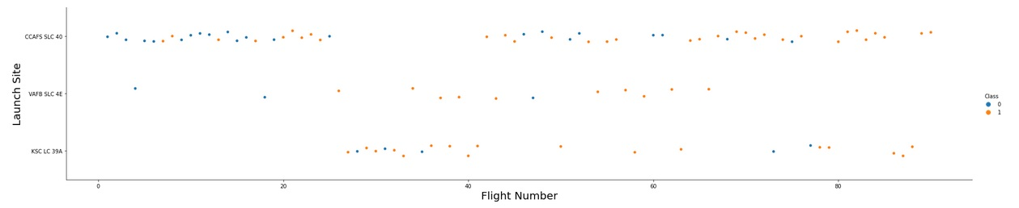
Flight Number vs. Launch Site
The visual above shows the distribution of flight numbers over the three launch sites. Most of the flight numbers ranging between 0 and 25 are launched from CCAFS SLC 40, while most of the flight numbers ranging between 25 and 40 are launched from KSC LC 39A
VAFB SLC 4E has a distribution of flight numbers mostly ranging between 35 and 65. It also appears to launch the fewest number of rockets
KSC LC 39A launches flight numbers ranging from 25 to 90, with most numbers concentrated between 30 and 40
CCAFS SLC 40 launches the most rockets and ranges between 0 and 25 with a noticeable gap and then from about 40 to 90

Slide 19
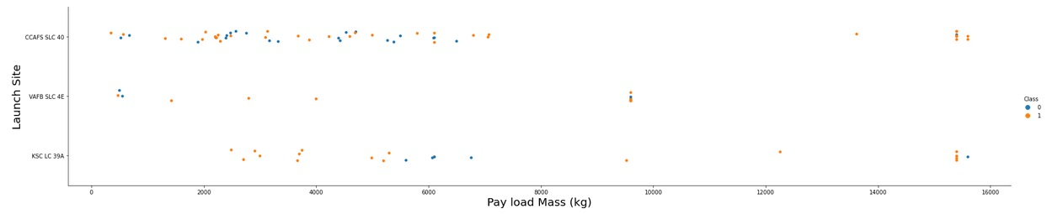
Payload vs. Launch Site
The visual above shows that CCAFS SLC 40 launches the most flights, with a majority being below 7000kg payloads. This launch site also handles the heaviest payloads, in the 15,000kg range.
VAFB SLC 4E does not launch any payloads above 10,000kg and appears not to be a suitable launch site for the heavier payloads. However, a majority of payloads just shy of the 10,000kg mark are launched from this site.
KSC LC 39A launches rockets with payloads ranging from about 2500kg right up to the heaviest payloads. It has launched no rockets with payloads less than 2000kg, which might indicate that the fixed costs of launching might be higher at this site, thus requiring larger minimum payloads to be profitable. Testing this hypothesis would require further investigation.
19

Slide 20
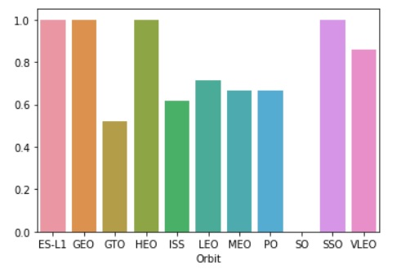
Success Rate vs. Orbit Type
The visual above shows that four of the orbits have 100% success rates: ES-L1 GEO, HEO and SSO
The SO orbit has a success rate of 0%
Four of the remaining five orbits have success rates around 60%. Besides SO, only GTO has a success rate below 60%
20
20

Slide 21
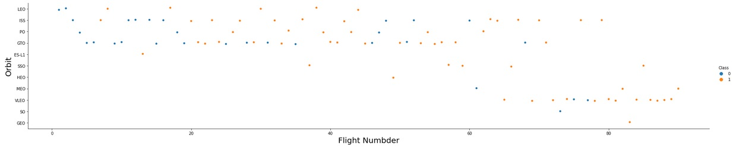
Flight Number vs. Orbit Type
The visual shows that the LEO orbit the Success appears related to the number of flights; on the other hand, there seems to be no relationship between flight number when in GTO orbit
The top left of the graph shows a higher concentration of lower flight numbers, many of them unsuccessful
The lower right shows more of the higher flight number, which enjoyed more success
21
21

Slide 22
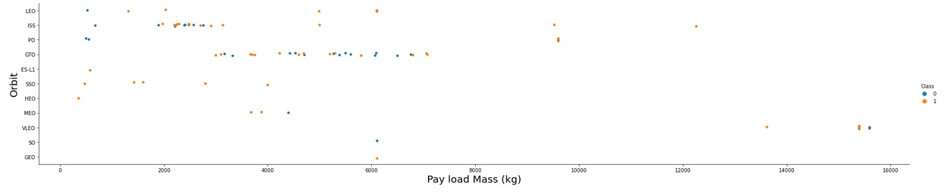
Payload vs. Orbit Type
With heavy payloads the successful landing or positive landing rate are more for Polar, LEO and ISS.
For GTO we cannot distinguish this well as both positive landing rate and negative landing(unsuccessful mission) are both present
Most light-medium (2500kg to 8000kg) payloads are in the GTO orbit
The lightest payloads have the most success in the ES-L1, SSO and HEO, although we have to be careful because of the extremely low sample size of small payloads to these orbits
22
22
22

Slide 23
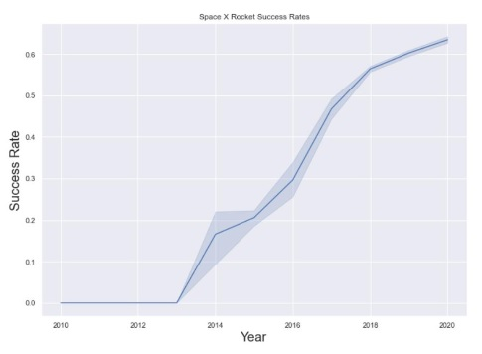
Launch Success Yearly Trend
Overall, the success rate has continued to increase since 2013
The success rate improved sharply between 2013 and 2014 and then slowed between 2014 and 2015
The company enjoyed the most success in 2020
23
23
23

Slide 24
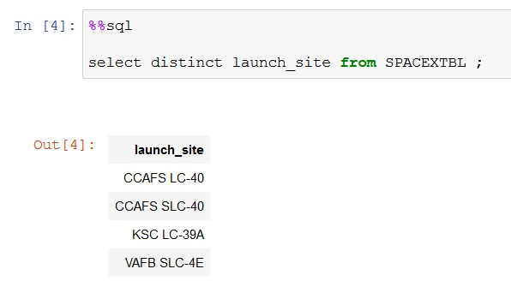
All Launch Site Names
The dataset shows that there are 4 unique launch sites
24
24
24

Slide 25
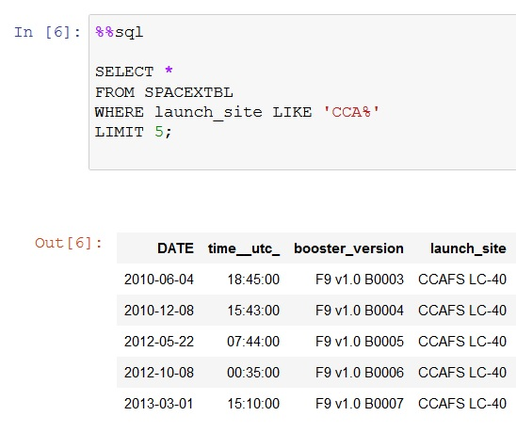
Launch Site Names Begin with 'CCA'
Retrieving 5 records where the Launch Site Name begins with CCA
In this case, all 5 records are for the launch site CCAFS LC-40
25
25
25
25

Slide 26
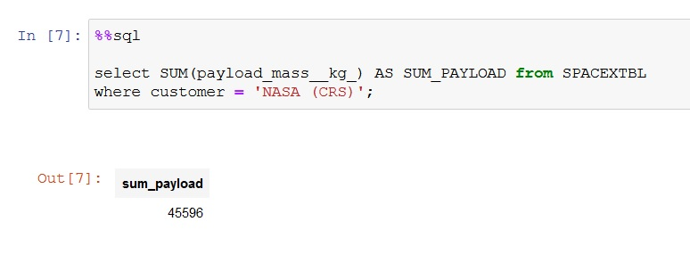
Total Payload Mass
The total payload (sum of all payloads) carried by boosters launched by NSA (CRS) is 45,596kg
26
26
26
26
26

Slide 27
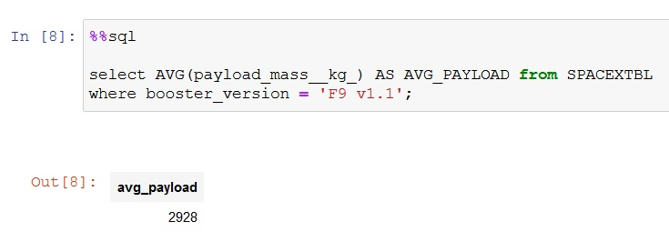
Average Payload Mass by F9 v1.1
The average payload mass carried by booster version F9 v1.1 is 2928kg
This would mean that the F9 v1.1 booster is primarily carrying smaller payloads
27
27
27
27
27
27

Slide 28
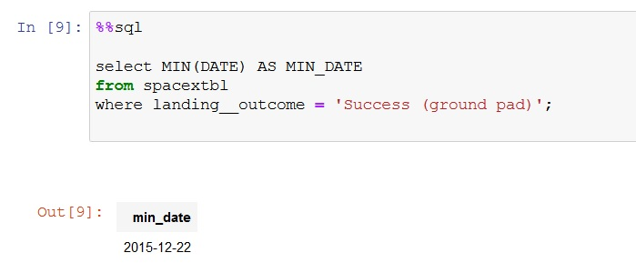
First Successful Ground Landing Date
The date when the first successful landing outcome in ground pad was achieved occurred on 2015-12-22
28
28
28
28
28
28
28

Slide 29
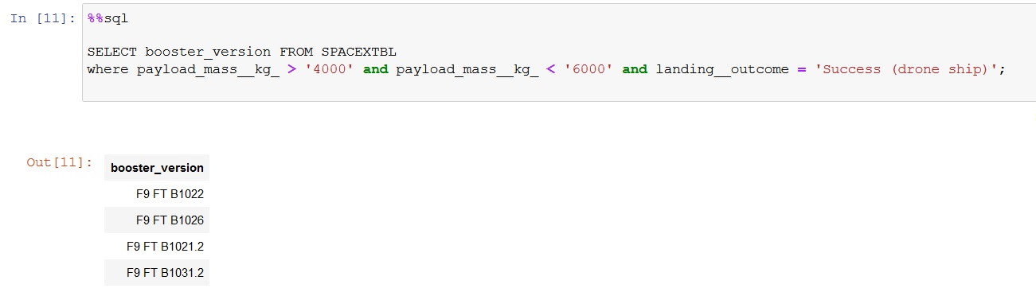
Successful Drone Ship Landing with Payload between 4000 and 6000
Four different booster versions achieved successful drop shop landings with payloads between 4000 and 6000 kg
29
29
29
29
29
29
29
29

Slide 30
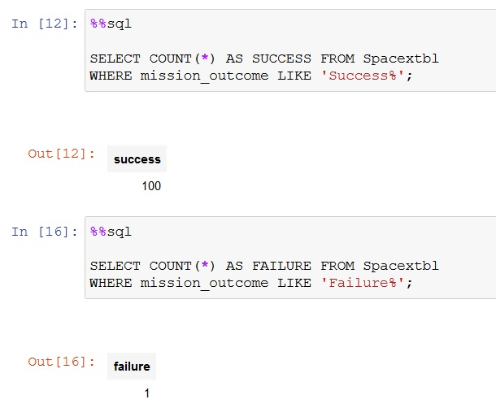
Total Number of Successful and Failure Mission Outcomes
There have been 100 successful missions
There has been only 1 failed mission
30
30
30
30
30
30
30
30
30

Slide 31
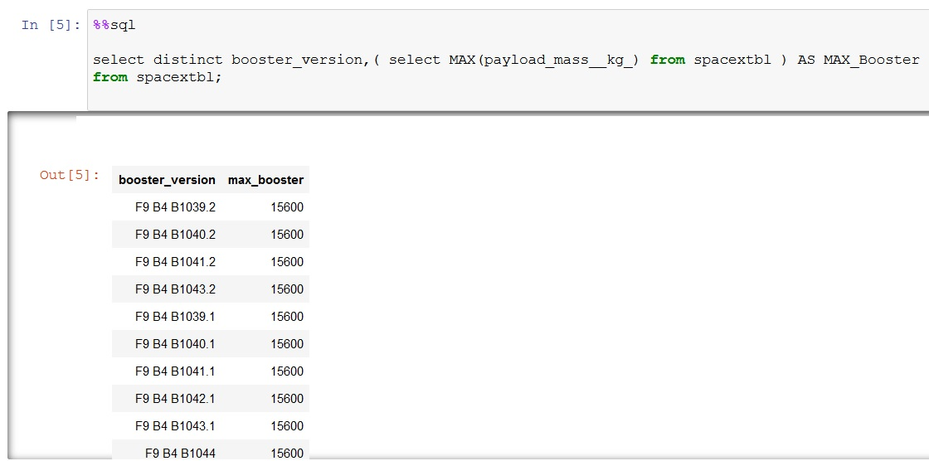
Boosters Carried Maximum Payload
A partial list of distinct booster versions which have carried the maximum payload (15,550kg)
By inserting the code: count(distinct booster_version) we can see that there are 97 distinct boosters which have carried the maximum payload
31
31
31
31
31
31
31
31
31
31

Slide 32
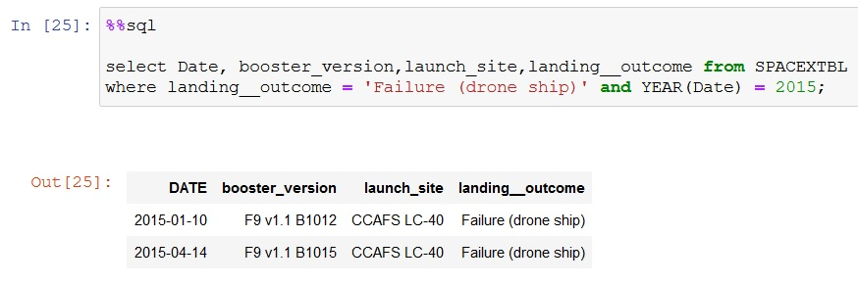
2015 Launch Records
The failed landing outcomes in drone ship, their booster versions, and launch site names for in year 2015 is listed above
32
32
32
32
32
32
32
32
32
32
32

Slide 33
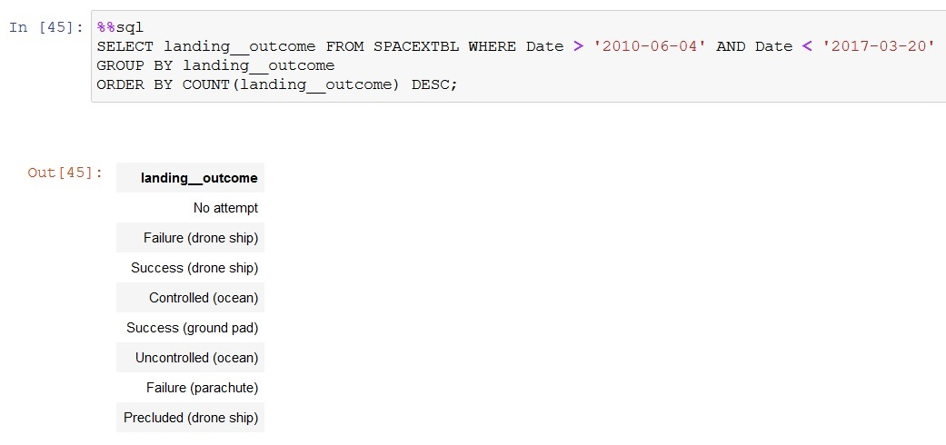
Rank Landing Outcomes Between 2010-06-04 and 2017-03-20
The above list is a ranked count of landing outcomes (such as Failure (drone ship) or Success (ground pad)) between the date 2010-06-04 and 2017-03-20 in descending order
33
33
33
33
33
33
33
33
33
33
33
33

Slide 34


Slide 35
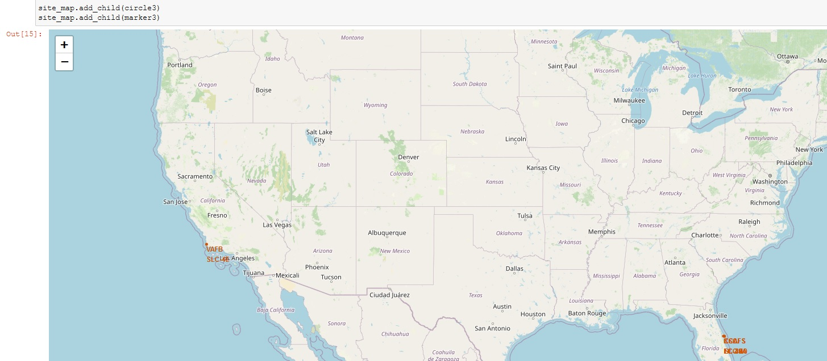
Launch Site Locations
The map shows the locations of the four launch sites
VAFB SLC-4E is located in California, while the other three sites are located in Florida
The three Florida sites are very close in proximity, all situated around the Cape Canaveral Space Force Station
35
35
35
35
35
35
35
35
35
35
35
35
35

Slide 36
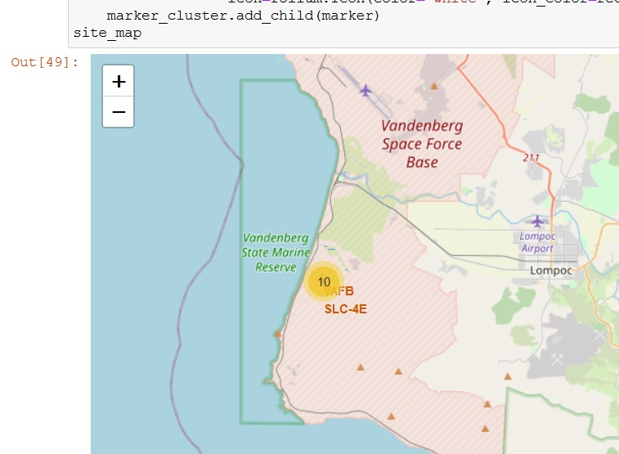
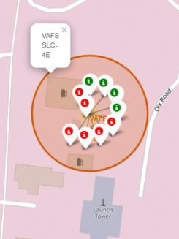
Marking the Success/Fail Launches for each Launch Site Locaction
The map shows the locations of the VAFB SLC-4E launch site
Zooming in, we can see the green dots representing the successful launches while the red dots indicate the failed launches for this particular launch site.
36
36
36
36
36
36
36
36
36
36
36
36
36

Slide 37
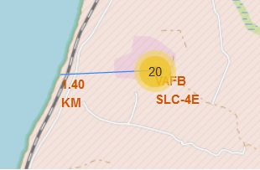
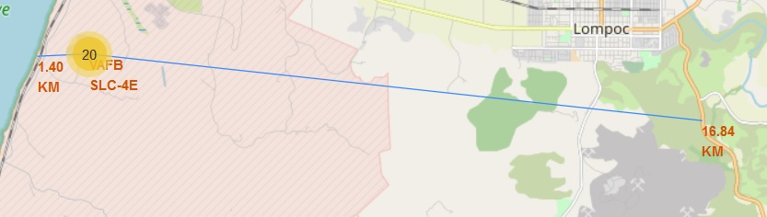
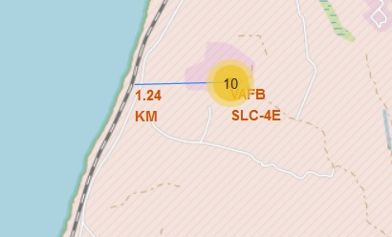
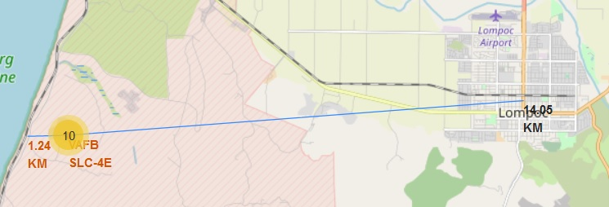
Launch Site Distances to Major Landmarks
The map shows the locations of the VAFB SLC-4E launch sites relative to major landmarks
The site is about 1.4km from the coast, 1.24k from the nearest railroad, 16.84km from major highway CA 1 and about 14km from the Lompoc city centre
Using this launch site as a reference, they are fairly close to highways and coastlines but keep a distance from highways and cities

Slide 38


Slide 39
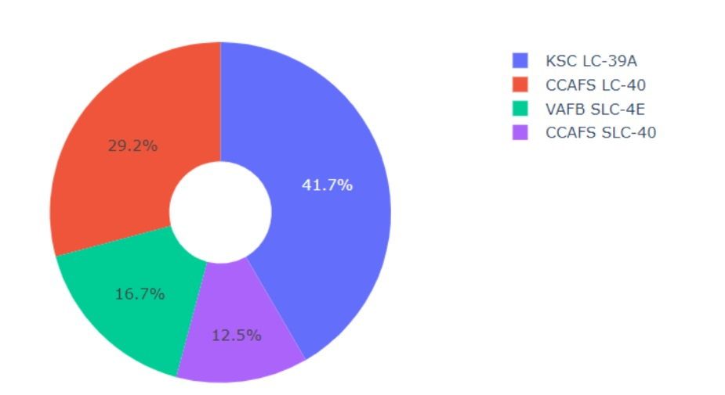
Success Rate By Launch Sites
KSC LC – 39A has the highest success rate of all the launch sites at 41.7%
CCAFS SLC-40 has the lowest success rate at 12.5%
39
39
39
39
39
39
39
39
39
39
39
39
39
39

Slide 40
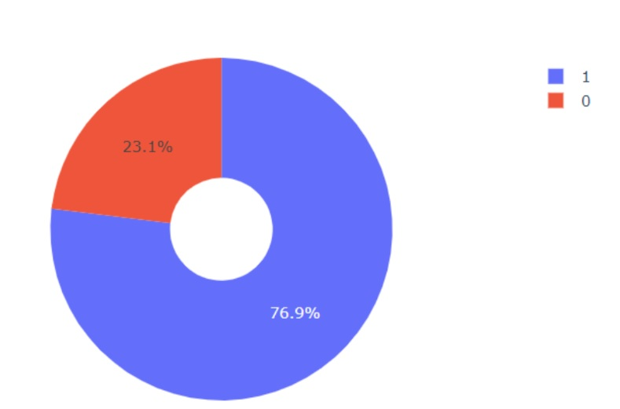
Breakdown of KSC LC-39A
KSC LC – 39A had the highest success rate so let’s look at the breakdown of successes vs failures
This site achieved 76.9% success rate and experienced only 23.1% of missions resulting in a fail
40
40
40
40
40
40
40
40
40
40
40
40
40
40
40

Slide 41
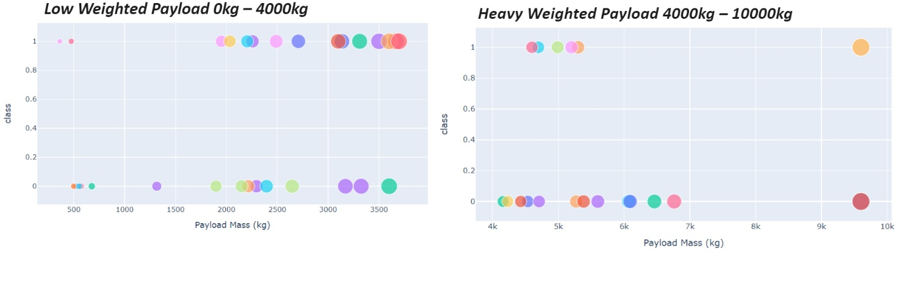
Payload vs Launch Outcomes
The range slider shows that there is a higher success rate for launches that have lower payloads
We also see that, around the 5500 to 7000kg payload there are almost no successes. This could mean they are using the wrong rocket type at these payloads or there could be some other underlying issue that would require further investigation
41
41
41
41
41
41
41
41
41
41
41
41
41
41
41

Slide 42


Slide 43
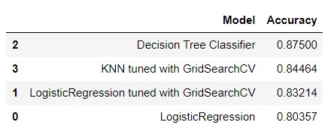
Classification Accuracy
The data shows that the Decision Tree Classifier performed the best
This model had an accuracy score of about 3 percentage points higher than KNN tuned with GridSearch, which placed second.
After tuning the hyperparameters, the Decision Tree Classifier still had the highest accuracy score, rising to 0.94444
43
43
43
43
43
43
43
43
43
43
43
43
43
43
43
43

Slide 44
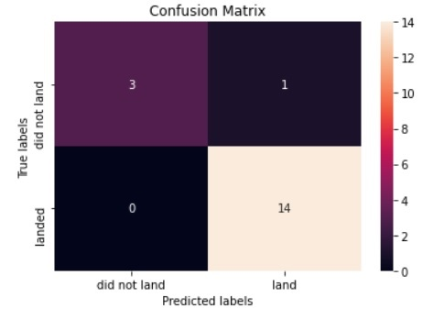
Confusion Matrix
The confusion matrix for the Decision Tree Classifier after tuning its hyperparameters shows that it can predict, with high accuracy, with rockets successfully land (lower right quadrant) and which rockets failed to land (upper left quadrant). These are considered the True Positives and True Negatives, respectively.
When building a model, it is important to achieve good accuracy but not at the expense of recall or precision scores. We can see the model predicts 0 False Negatives (lower left quadrant) and only 1 False Positive (upper right quadrant).
We MIGHT be sacrificing the precision or recall scores to get a very high accuracy score. This should be examined further. For example, it might be VERY costly to predict a successful landing when the outcome will be a failed landing. Therefore, we should focus on maximizing the False Positives, even if it lowers the accuracy of the model.
44
44
44
44
44
44
44
44
44
44
44
44
44
44
44
44

Slide 45
Predictive Analysis Conclusions
When building our predictive classification model, we found that the Decision Tree Classifier gave us the highest ACCURACY score
We need to treat this with caution, however, because we did not check if the high accuracy score came at a cost to our recall and precision scores. These latter scores measure the minimization of False Negatives and False Positives.
It can be assumed that False Positives are the biggest issue facing this model. It would be far more costly to predict a successful mission, send a rocket into space, and then experience a failed landing, which might severely damage the rocket and make it not fit for reuse. A False Negative, on the other hand, may just cause mission control to cancel a mission because it is predicted to fail even when it will not. There are still costs involved, but probably much lower.

Slide 46
Overall Conclusions
We used the Decision Tree Classifier to maximize Accuracy scores
We found that rockets carrying payloads with smaller masses had higher success rates than rockets carrying payloads with heavier masses, in general
The launch site KSC LC-39A had the highest success rate of the four sites
Launch sites are generally built near the coast and close to railway systems, while keeping a further distance from cities and major highways, probably due to safety concerns for the general population
Four Orbits share the highest success rates: HEO, GEO, SSO, ES-L1

Slide 47
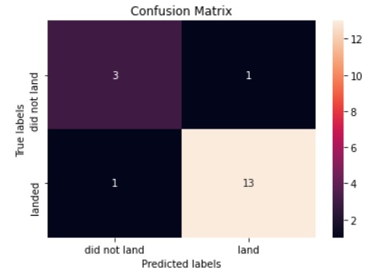
Appendix
The above confusion matrix is indicative of the danger of maximizing accuracy scores without considering the recall or precision score. This matrix is for the Decision Tree Classifier prior to tuning the hyperparameters. It shows 1 False Negative
After tuning the hyperparameters, the False Negative is ‘correctly’ labeled as a True Positive, however, we have identified that False Negatives are not as ‘costly’ as False Positives
Our model would be better, in my opinion, if we could focus on properly reclassifying the False Positive in the upper right quadrant. Even if this means an increase in False Negatives.
Minimizing failed landings is the most important goal to reduce costs and increase safety and reputation
47
47
47
47
47
47
47
47
47
47
47
47
47
47
47
47
47

Slide 48


